Slide 1


Remote Procedure Call
SE3331-1 (2024 Fall)
IPADS, Shanghai Jiao Tong University
https://www.sjtu.edu.cn
Credits: Rong Chen@IPADS

Slide 2
Distributed system that support large-scale websites
Large-scale websites are composed of different distributed systems
Request processing, data storage
Caching server
Caching server
Caching server
…
Caching
Caching
Caching
Distributed caching
Database server
Database server
CDN
Users
Application #1
generate the page
Database
user, price
…
Database
user, price
Application server
Distributed database
Internet
Load
Balance
Application #2
add the order
File server
File server
File server
File:
image
File:
image
…
File:
image
Application server
…
…
Message queue
Distributed file system

Slide 3
Example: extend a single-node filesystem to a distributed one
Large-scale websites are composed of different distributed systems
Request processing, data storage
How each system communicates?
Caching server
Caching server
Caching server
…
Caching
Caching
Caching
Distributed caching
Database server
Database server
CDN
Users
Application #1
generate the page
Database
user, price
…
Database
user, price
Application server
Distributed database
Internet
Load
Balance
Application #2
add the order
File server
File server
File server
File:
image
File:
image
…
File:
image
Application server
…
…
Message queue
Distributed file system

Slide 4
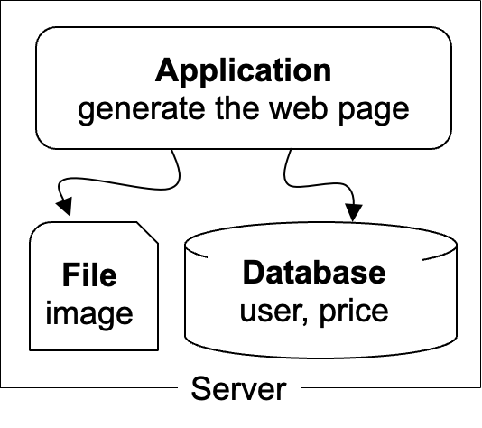


Recall: The architecture of LAMP cannot scale!
https://www.taobao.com
Internet
The disk & memory of one server cannot store massive amount of data
DRAM: 64 – 256 GB
HDD: 2 – 40 TB
Facebook has more than 1 billion of images uploaded weekly, Baidu stores tens of billions of web pages
File:
image
Database:
user, price
See previous lectures
DRAM
HDD

Slide 5


Step #1 for scalability: disaggregating application & data
Scale
Application: handles application logic
Can be scaled with more CPUs
Database: requires reading/writing disk & cache
Can be scaled with faster disks & larger memory
File system: store large bulks of data
E.g., images, videos
Can be scaled with faster disks
Application
generate the web page
Application server
Local area network
File server
Database server
Scale
Scale
File:
image
Database
user, price
Database
user, price
How to do so?
Notes:
// TODO: add figure

Slide 6
Remote Procedure Call (RPC)
“Remote procedure calls (RPC) appear to be a useful paradigm.”
— Birrel & Nelson, 1984
Andrew Birrell, Bruce Nelson, “Implementing Remote Procedure Calls”. ACM Transactions on Computer Systems (TOCS), 2(1), 1984

Slide 7
filesystem + RPC, a form of distributed filesystem
Calling a function on a remote server like a local one !
Application
generate the web page
Read()
Done()
Application server
Read()
File server
Read()
Read()
Write()
Etc.
File:
image

Slide 8
RPC vs. Sockets API
The sockets interface forces a read/write mechanism
read(), write(), sendmsg(), etc.
Programming is often easier with a functional interface
To make distributed computing look more like centralized computing
Goal of RPC:
It should appear to the programmer that a normal call is taking place
Idea: build the RPC atop of the socket interface
Hide the construction of messages and remote invocation logic from the developers

Slide 9



RPC: Remote Procedure Call
Allow a procedure to execute in another address space without coding the details for the remote interaction
RPC History
Idea goes back in 1976
Sun's RPC: first popular implementation on Unix
Used as the basis for NFS
Many modern RPC frameworks: gRPC, bRPC, etc.
RMI (Remote Method Invocation)
Object-oriented version of RPC, e.g. in Java

Slide 10
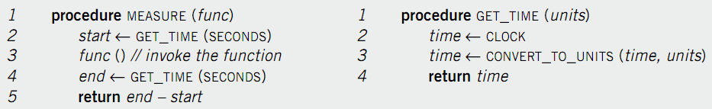
Example of RPC
The implementation of GET_TIME.
Suppose we want to measure the execution time of func()
Assumption:
Only the server has the implementation of GET_TIME
How can the client call server’s GET_TIME?

Slide 11

Call GET_TIME in a single machine case
GET_TIME
func()
GET_TIME
Client

Slide 12
Single-machine call vs. distributed call（RPC）
Call(get_time)
GET_TIME
func()
Client
Call(get_time)
GET_TIME
Server

Slide 13
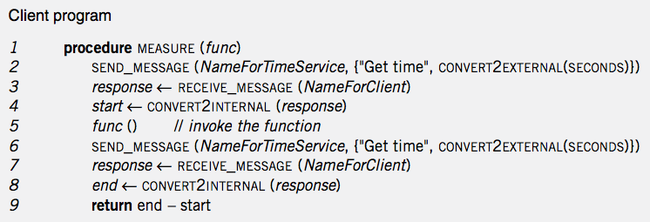
Handwritten code: client
Call(get_time)
Local
func()
Client
Call(get_time)
RPC

Slide 14
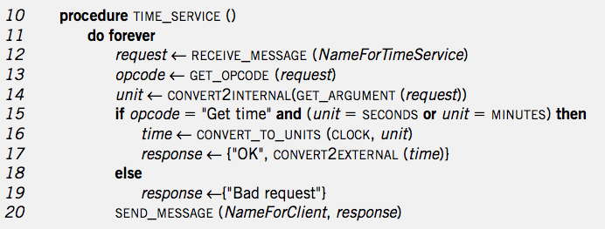
Handwritten code: server
GET_TIME
TIME_SERVICE
Client
Server

Slide 15
RPC simplifies the implementation of remote calls
Abstracts away the common parts with stub
Provided in
RPC’s stub

Slide 16
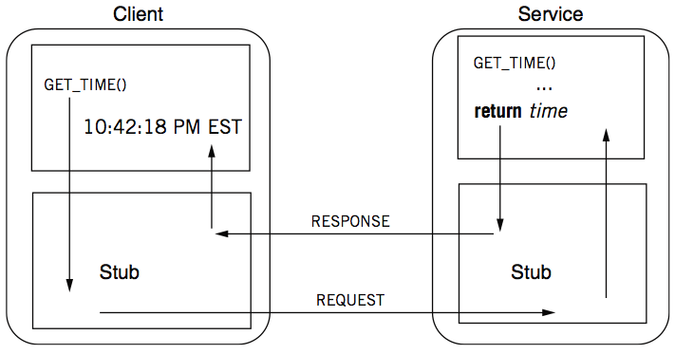
RPC: a complete calling process

Slide 17
RPC stub
Client stub
Put the arguments into a request
Send the request to the server
Wait for a response
Service stub
Wait for a message
Get the parameters from the request
Call a procedure according to the parameters (e.g. GET_TIME)
Put the result into a response
Send the response to the client
Stub: hide communication details from up-level code, so that up-level code does not change.

Slide 18
Client Program using RPC
procedure MEASURE (func)
start <- GET_TIME(SECONDS)
func()
end <- GET_TIME(SECONDS)
return end - start
Note: code is not changed comparing
with the single-machine case
This is the stub of client
procedure GET_TIME (units)
SEND_MESSAGE(ServerName, {"Get time", CONVERT2EXTERNAL(units)})
response <- RECEIVE_MESSAGE(ClientName)
if GET_RETCODE(response) != "OK"
HANDLE_ERROR(response)
else
return CONVERT2INTERNAL(GET_ARGUMENT(response))

Slide 19
Server Program using RPC
procedure GET_TIME (units)
time <- CLOCK
time <- CONVERT_TO_UNITS(time, units)
return time
Note: this code is not changed
This is the stub of server
procedure TIME_SERVICE ()
do forever
request <- RECEIVE_MESSAGE(ServerName)
opcode <- GET_OPCODE(request)
arg <- CONVERT2INTERNAL(GET_ARGUMENT(request))
if opcode = "Get time" and (arg = SECONDS or arg = MINUTES) then
retval <- GET_TIME(arg)
response <- {"OK", CONVERT2EXTERNAL(retval)}
else
response <- {"Bad request"}
SEND_MESSAGE(ClientName, response)

Slide 20
Question: what is inside a message?
procedure GET_TIME (units)
SEND_MESSAGE(ServerName, {"Get time", CONVERT2EXTERNAL(units)})
response <- RECEIVE_MESSAGE(ClientName)
if GET_RETCODE(response) != "OK"
HANDLE_ERROR(response)
else
return CONVERT2INTERNAL(GET_ARGUMENT(response))
procedure TIME_SERVICE ()
do forever
request <- RECEIVE_MESSAGE(ServerName)
opcode <- GET_OPCODE(request)
arg <- CONVERT2INTERNAL(GET_ARGUMENT(request))
if opcode = "Get time" and (arg = SECONDS or arg = MINUTES) then
retval <- GET_TIME(arg)
response <- {"OK", CONVERT2EXTERNAL(retval)}
else
response <- {"Bad request"}
SEND_MESSAGE(ClientName, response)

Slide 21
Question: what is inside a message?
A message may contain:
Service ID (e.g., function ID)
Service parameter (e.g., function parameter)
Using marshal / unmarshal

Slide 22
RPC request message
RPC request:
Xid
call/reply
rpc version
program #
program version
procedure #
auth stuff
arguments
X is short for "transaction"
Client reply dispatch uses xid
Client remembers the xid of each call
Server dispatch uses prog#, proc#

Slide 23
RPC reply message
RPC reply:
Xid
call/reply
accepted? (Yes, or No due to bad RPC version, auth failure, etc.)
auth stuff
success? (Yes, or No due to bad prog/proc #, etc.)
results

Slide 24
Binding: find the server
Can implement with other network name services
E.g., 192.168.10.233:8888 + function ID
Example: gRPC
gRPC client
grpc::CreateChannel("localhost:50051",
grpc::InsecureChannelCredentials());
binding
gRPC server
std::stringserver_address("0.0.0.0:50051");
...
... AddListeningPort(server_address, ...);

Slide 25
How to pass the data between
client & server?

Slide 26
Parameter passing
Pass by value?
Easy: just copy data to network message
Pass by reference?
Makes no sense without shared memory
Needs a conversion between data used in a program vs. data that can be transferred through the network
Client converts data structure into pointerless representation
Client transmits data to the server
Server reconstructs structure with local pointers

Slide 27
Parameter passing is challenging across machines
Distributed systems have the incompatibility problem
which does not exist on a single machine
For example, remote machine may have different
byte ordering,
sizes of integers and other types,
floating point representations,
character sets,
alignment requirements
etc.
Represent 0x89abcdef
Big endian, e.g., Power processor
89
AB
CD
EF
0
1
2
3
Little endian, e.g., X86
EF
CD
AB
89
0
1
2
3

Slide 28
Parameter passing is more challenging
Application is changing over time
What would happen if a server upgrades while the client is intact?
E.g., server upgrades and adds a priority field to its message, what would happen if the client does not change?
Evolvability: we should built systems that are easy to adapt to changes!
Backward compatibility: newer code can read data that was written by older code
Forward compatibility: older code can read that was written by newer code
Notes:
例子：手机

Slide 29



Representing data: encoding
Need standard encoding to enable communication between heterogeneous systems & different versions of software
Sun’s RPC uses XDR (eXternal Data Representation)
ASN.1 (ISO Abstract Syntax Notation)
JSON
Google Protocol Buffers
W3C XML Schema Language

Slide 30


Why not using language-specific formats?
Many languages have built-in support for encoding in-memory objects
Java’s java.io.Serializable
Python’s pickle
Drawbacks:
The encoding is tied to a particular programming language
E.g., it’s challenging to use a Java client to call a python server
No versioning -> no forward and backward compatibility

Slide 31
System requirements for encoding/decoding
Transfer objects through the network
Correctly encode and decode a object to a byte stream
Compatibility
Support multiple language, multiple versions of program
Efficiency
Reduce the traffic transferred from the network
Network bandwidth is a scarce resource

Slide 32
Standardized encoding: JSON, XML & etc.
Independent to a specific programming language
Textual formats:
JSON
XML
CSV
Logic client request format
Xid
call/reply
rpc version
program #
program version
procedure #
auth stuff
arguments
JSON representation
{ “xid” : 12, ”call”: true,
“rpc_version”: 73,
...
}

Slide 33
Standardized encoding: JSON, XML & etc.
Independent to a specific programming language
Textual formats:
JSON
XML
CSV
Benefits:
Human-readable: easy to debug

Slide 34
Standardized encoding: JSON, XML & etc
Independent to a specific programming language
Textual formats:
JSON
XML
CSV
Drawbacks:
Ambiguity around encoding of numbers
How to support binary strings?
Programmers have to re-encode the string as Base64, etc.
3. Verbose: use more bytes to store the data. E.g., tags like <xx> </xx> in XML
How may bytes
should I use to store
the number?
JSON representation
{ “xid” : 12, ”call”: true,
“rpc_version”: 73,
...
}

Slide 35
Binary formats
Encode the data using binary encoding
Pros: more compact, more accurate, faster to parse and store
Cons: less human-readablity
Not a problem when the data is only used internally
E.g., RPC message metadata
Typical example: Thrift & Protocol Buffers
Thrift, by Facebook, now in Apache
Protocol Buffers, by Google
{ "userName": "Martin", "favoriteNumber": 1337, "interests": ["daydreaming", "hacking"] }
JSON representation takes 81B in total (w/o spaces)
Binary formats can reduce it to 34B or even less

Slide 36
Binary formats: schema
Both Thrift and Protocol Buffers require a schema for any data that is encoded
Benefits: no need to encode things such as userName in the encoded data
Thrift interface definition language (IDL)
Protocol Buffers IDL
struct Person { 1: required string userName, 2: optional i64 favoriteNumber,
3: optional list<string> interests
}
message Person {
required string user_name = 1;
optional int64 favorite_number = 2;
repeated string interests = 3;
}
{ "userName": "Martin", "favoriteNumber": 1337, "interests": ["daydreaming", "hacking"] }
JSON representation takes 81B in total (w/o spaces)
Notes:
Int64 remove the ambiguity of JSON formats

Slide 37
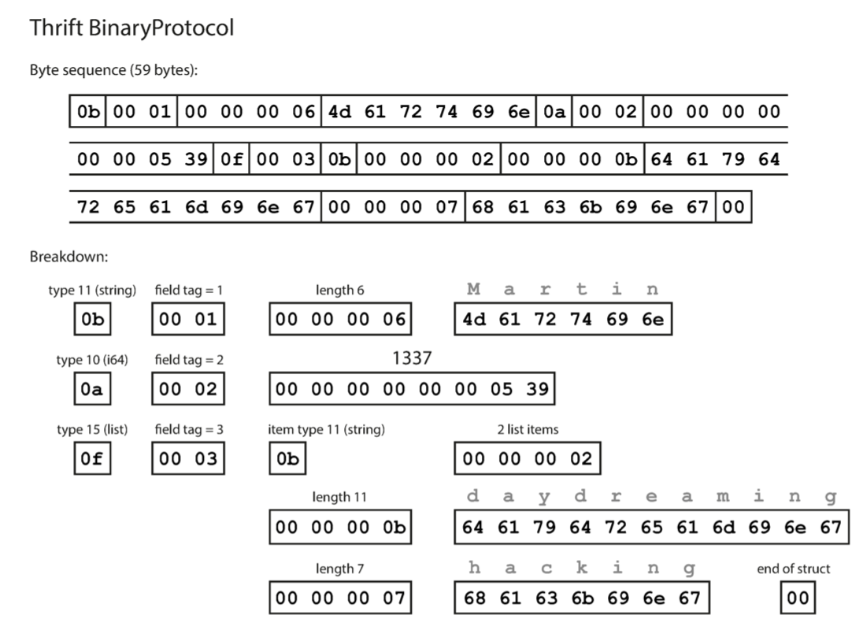
The BinaryProtocol of Thrift
Each field has:
Type annotation (1B)
Type field (1B)
A length indication (optional, required for string, list, etc.)
Data (like json)
For each type, the protocol assumes an internal encoding
E.g., little endian
Total 59B
no field names (userName, favoriteNumber, interests)

Slide 38
Being more compact: Thrift CompactProtocol
Techniques:
Packing field type & field tag in 1B
Variable-length integer: top-bit of each byte indicates whether there are more bytes
1
2

Slide 39
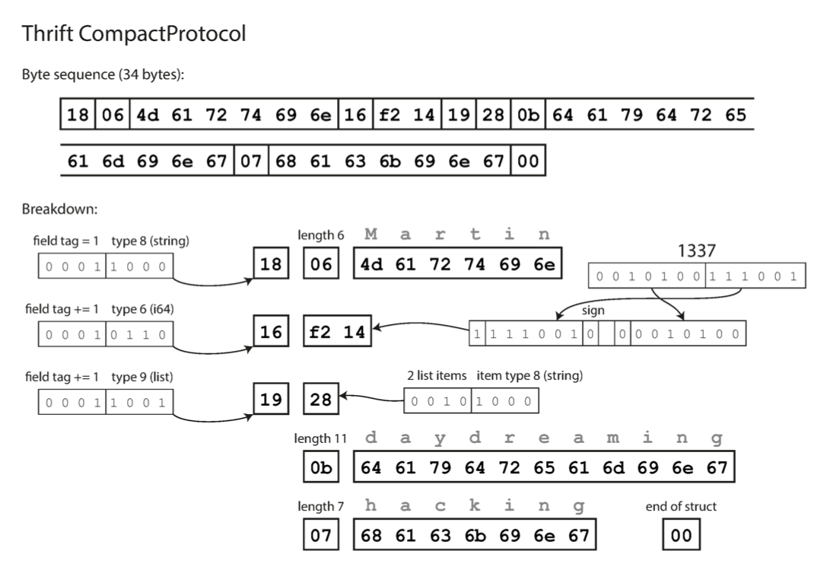
Being more compact: Thrift CompactProtocol
Techniques:
Packing field type & field tag in 1B
Variable-length integer: top-bit of each byte indicates whether there are more bytes 1337: from 8B to 2B
Now only consumes 34B

Slide 40
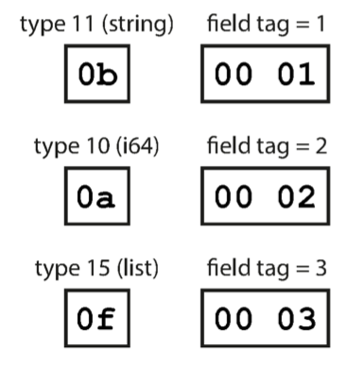
Schema simplifies supporting compatibility
Key observation: we only need to keep the field tags & field type compatible
Forward compatible: if new schema preserves the presentation of old schema, then new code can trivially decode the data encoded with old schema
Backward compatible: old code can simply skip fields with unknown field tag

Slide 41
Short summary of parameter passing in RPC
Passing data using RPC is non-trivial, should ensure:
Correctness
Compact
Evolvable
Encoding/decoding
Convert an object into an array of bytes with enough annotation so that the decode procedure can convert it back into an object
Also known as marshal / unmarshal in RPC
With other names, e.g., serialize / unserialize or deserialize

Slide 42
Automatic stub generation
Generate stubs from an interface specification
Tool to look at argument and return types
Generate the marshal and unmarshal code
Generate stub procedures
Benefits:
Saves programming (thus less error)
Ensures agreement on argument types
E.g., consistent function ID
Typically a standard component in an RPC library

Slide 43
Transport protocol of RPC
Stubs also include implementations of sending/receiving messages
TCP or UDP, which one to use?
What about new networking features, e.g., RDMA?
Hide the transport protocol from the user
Benefits: e.g., transparent migrate to a more advanced network
Most support several
Allow programmer (or end user) to choose at runtime based on their hardware setup or performance requirements

Slide 44
Short summary of encoding & decoding data for RPC
Transfer objects through the network
Correctly encode and decode a object to a byte stream
Compatibility
Support multiple language, multiple versions of program
Efficiency
Reduce the traffic transferred from the network
Network bandwidth is a scarce resource
Uniformed format + Schema
Binary format

Slide 45
Short summary of encoding & decoding data for RPC
Efficiency
Reduce the traffic transferred from the network
Network bandwidth is a scarce resource
Question
Does binary format always improve the efficiency of RPC?
E.g., What if the network is becoming faster?

Slide 46
Short summary: RPC so far
RPC simplifies programming w/ an interface similar to local function call
RPC uses stubs to avoid handling argument encoding/decoding and send/receiving messages, etc.
Ensure correctness & efficiency
Remain challenges of RPC：
How to handle failure?
As we have mentioned, failure is common especially in large-scale distributed systems!

Slide 47
When RPC meets failure

Slide 48
When RPC meets failures
Local procedure calls do not fail (most of the time)
If that happens, the entire process dies
RPC may meet many different failures
Parameter error -> just return
Server crash -> how the client copes with it?
Crash can happen even the remote procedure runs correctly!

Slide 49
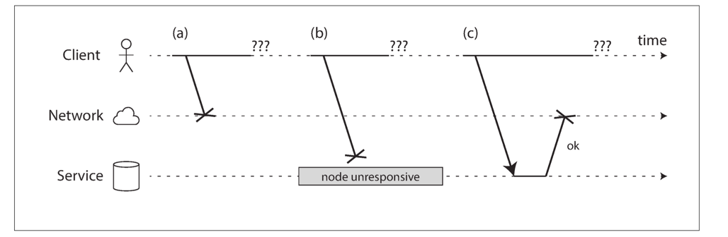
When RPC meets failures
RPC could fail in a partial failure way
Like what we have presented in lecture 02
A client uses RPC to call a function at a service through the network
The client does not get any reply
What could possibly happen?

Slide 50
When RPC meets failures
A user sends an RPC but the server does not reply, possible reasons:
1. Request may have been lost (e.g., someone unplugged a network cable).
2. Request may be waiting in a queue and will be delivered later (e.g., the network or the recipient is overloaded).
3. The remote node may have failed (e.g., it crashed or it was powered down).

Slide 51
When RPC meets failures
A user sends an RPC but the server does not reply, possible reasons:
4. The remote node may have temporarily stopped responding (e.g., it is experiencing a long garbage collection pause)
5. The remote node may have executed the function, but the response has been lost on the network (e.g., a network switch has been misconfigured).
6. The remote node may have executed the function, but the response has been delayed and will be delivered later (e.g., the network or your own machine is overloaded).

Slide 52
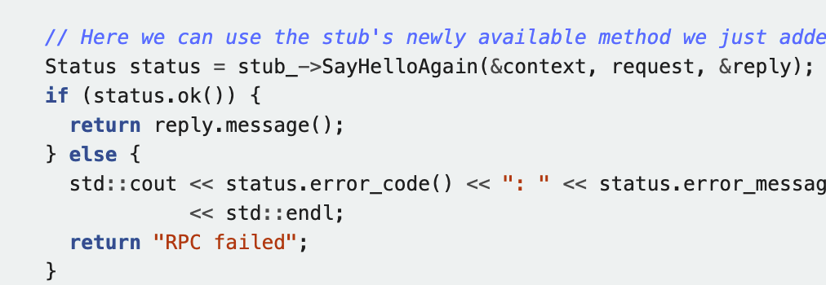
RPC != PC
The transparency of RPC breaks here:
Applications should be prepared to deal with RPC failure
E.g., gRPC will return a status for application to check

Slide 53
When RPC meets failures
Semantics of remote procedure calls
Local procedure call: Exactly once
A remote procedure call may be called:
0 time: server crashed or serve process died before executing server code
1 time: everything worked well, as expected
1 or more: excess latency or lost reply from server and client retransmission
0 or 1 time: the function can execute at most once
What is the most desirable RPC semantic for the developers?
What is the desirable RPC semantic for system developers?

Slide 54
RPC semantic
Most RPC systems will offer either:
At-least-once semantics
At-most-once semantics
Simple retransmission leads to "at-least-once"
Birrell’s RPC semantics (1984) :
server says OK: executed once
server says CRASH: zero or one time
much easier than exactly once, more useful than at-least-once

Slide 55
RPC semantic
Understand application:
Idempotent: may be run any number of times without harm (e.g., i = 1)
Non-idempotent: those with side-effects (e.g., i++)
When at-least-once is OK?
if no side effects (e.g., read-only operation)
if app has its own plan for detecting duplication

Slide 56



Cases of idempotence
“Idempotence means that multiple invocations of some work are identical to exactly one invocation.”
——Pat Helland
Sweeping the floor is idempotent
Pressing the elevator button is idempotent
Saving money is non-idempotent

Slide 57
Idempotence in RPC
RPC client
RPC server
Call(server, “ReadTime”);
ReadTime() {
return current_time;
}
Succ
C0
Failure & retry
Succ
C1
Server
ReadTime
ReadTime
ReadTime
Time

Slide 58
Idempotence in RPC
RPC client
RPC server
Expect ReadTime is called twice
Actually called 3 times
Is it ok? Why?
Call(server, “ReadTime”);
ReadTime() {
return current_time;
}
Succ
C0
Failure & retry
Succ
C1
Server
ReadTime
ReadTime
ReadTime
Time

Slide 59

Idempotence in RPC
RPC client
RPC server
Call(server, “Like”);
Like() {
counter++;
}
Succ
C0
Failure & retry
Succ
C1
Server
Like
Like
Like
counter=1
counter=2
counter=3
Time

Slide 60

Idempotence in RPC
RPC client
RPC server
Expect Like is called twice
Actually called 3 times
Is it ok? Why?
What about something like Vote?
Call(server, “Like”);
Like() {
counter++;
}
Succ
C0
Failure & retry
Succ
C1
Server
Like
Like
Like
counter=1
counter=2
counter=3
Time
Notes:
If it's vote, then the application needs to consider by itself: e.g., it can count the user name instead of using just a counter.

Slide 61
RPC semantic
Understand application:
Idempotent: may be run any number of times without harm
Non-idempotent: those with side-effects (e.g., call i++ at the server)
When at-least-once is OK?
If no side effect (e.g., read-only operation, ReadTime)
If app has its own plan for detecting duplication
E.g., record how many times a counter has been added

Slide 62
Ideal RPC Semantics: exactly-once
Like single-machine function call
Implement exactly-once semantics:
Server remembers the requests it has seen and replies to executed RPCs (need to across reboots)
Detect duplicates, requests need unique IDs (XIDs)

Slide 63
Idempotence in RPC
RPC client
RPC server
Call(server, “Like”);
Like(xid) {
if not see xid {
counter++;
}
}
Succ
C0
C0:#1
Failure & retry
Succ
C1
C1:#1
C1:#1
Server
Like
Like
Like
counter=1
counter=2
counter=2
Time

Slide 64
Ideal RPC Semantics: exactly-once
Like single-machine function call
Implement exactly-once semantics:
Server remember the requests it has seen and replies to executed RPCs (across reboots)
Detect duplicates, reqs need unique IDs (XIDs)
Assumption: failures are eventually repaired, and client retries forever
How to correctly recover from failure? See later lectures

Slide 65
Put it all together: RPC system components
1. Standards for wire format of RPC message and data types
2. Library of routines to marshal / unmarshal data
3. Stub generator, or RPC compiler, to produce "stubs"
For client: marshal arguments, call, wait, unmarshal reply
For server: unmarshal arguments, call real function, marshal reply

Slide 66
Put it all together: RPC system components
4. Server framework:
Dispatch each call message to correct server stub
Recall each called functions ,if provide at-most-once semantic or exactly-once semantic
5. Client framework:
Give each reply to correct waiting thread / callback
Retry if timeout or server cache
6. Binding: how does client find the right server?

